Slide 1
Anaplan Sales
Applications
Territory and Quota Planning
Post model generation updates
Application Version 2.1.0
Last updated August 26, 2025

Slide 2
Confidentiality notice
This documentation and any related materials are provided solely for the use of authorized Anaplan customers who have purchased the Anaplan Territory and Quota Planning Application and are considered Anaplan proprietary information. The information contained herein is intended exclusively for the purpose of implementing the application by authorized customers. Any use outside of this intended purpose is strictly prohibited, including but not limited to:
  Sharing, distributing, or disclosing this content with or to individuals or entities not directly involved in the customer’s authorized implementation.
  Using the documentation, in whole or in part, to replicate, retrofit, or reverse-engineer the functionality in other models, environments, or platforms.
This documentation contains proprietary information of Anaplan and is protected by applicable intellectual property laws. Any unauthorized use, reproduction, or dissemination is a violation of these terms and may result in legal action.

Slide 3

Post model generation updates
1
Miscellaneous updates
2
Saved View & Actions update
3
Lists & Data updates
4
Module & Line Item updates
5
App Pages updates
6
Security updates

Slide 4
Time and effort estimation​
*As a rough estimate, budget at least a day to complete those changes after generation.
Multiple areas will require updates to both the structure and user experience that are not generated with the models and application pages.
Depending on the level of configuration a customer has and how familiar the page builder is with the changes needed, the time to make the required changes so that the model will function as expected may vary.

Slide 5
Post model generation
Miscellaneous updates
Section 1

Slide 6
Possible application generation errors
Overview
In certain situations, an application may not generate the appropriate pages or may generate pages with objects mapped to incorrect modules.
Note: Check this first before making any other updates
Example:
Sales Role Load page, should generate with the grid sourced from SYS by Sales Role Flat, instead this grid may be pointing to a different, unrelated module.
*How to fix this:
Delete the model and the application
Regenerate the applications and models.
Action required:
Before you modify anything else in the model or application:
Verify that all pages have generated based on the selections and entries made in the configuration model.
Validate that the grids in the UX pages are referencing the expected and appropriate modules.

Slide 7

Check page number ordering
Helpful tip
Pages generate within their category in randomized order. They must be manually reordered.
(SPT-764)

Slide 8
Add page navigation buttons
Helpful tip
Navigation buttons are not included in the application. For improved user flow it is recommended to add navigation buttons between relevant pages. (SPT-222)

Slide 9
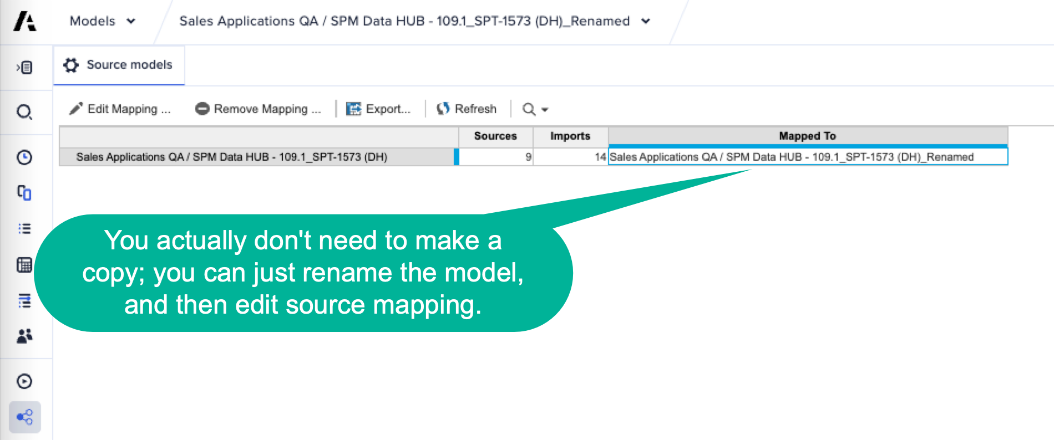
Possible self-to-self import issue
Overview
We have seen cases where a generated model, when imported to another workspace, is unable to execute any imports from itself (for example, from a saved view to a list). This happens because the source model's entry that you would need to edit is no longer visible, so you cannot edit it.
(SPT-477, SPT-581, SPT-2566)
How do I fix it?
Before you do anything else, either:
  Easy: Rename your generated data hub & spoke models
  Less easy: Copy generated data hub and spoke models or import the models to another workspace.
In each renamed/copied/imported model, go to the Source Models tab, edit all entries to point to the names or copies you just made so that the Mapped to column on the right is not blank.

Slide 10
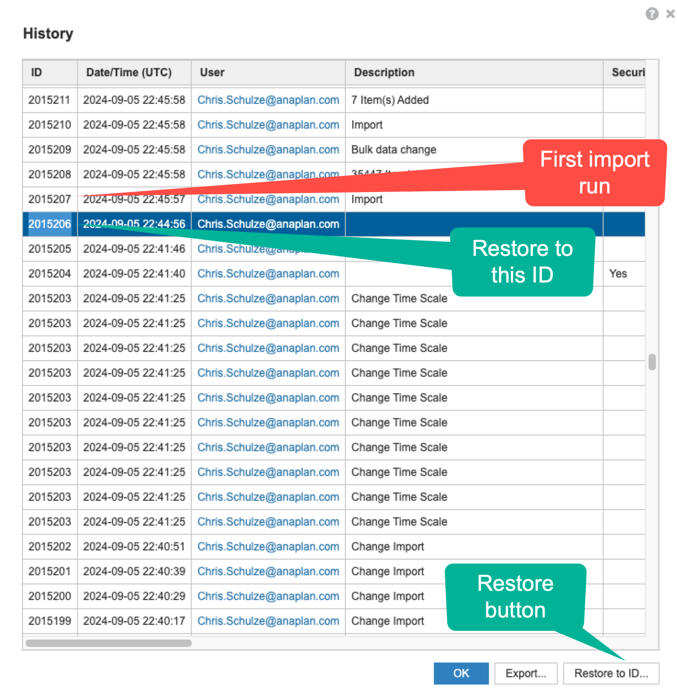
Possible self-to-self import issue (cont.)
What if I already have the problem where a source model's screen is missing the entry to edit? You have two options:
Restore each affected model
  Restore the models to a history ID before the first time a self-to-self import runs. Up until this point, the Source Model screen works.
  Make a copy of the restored models in the same workspace or import to another workspace.
  In the copied/imported models, edit the Source Model screen to map
  to this new instance instead of the original one.
Don't restore, fix
  Make a copy of the models in the same workspace or import to another workspace.
  Go to Actions->Import Data Sources.
  For each entry that serves a self-to-self import, copy the name of the source saved view from the Source Object Name column, edit the import data source, change to the correct copied/imported model, and reselect the correct saved view in this model copy.
  In the copied/imported models, edit the Source Model screen to map
  to this new instance instead of the original one.
(SPT-477, SPT-581)

Slide 11
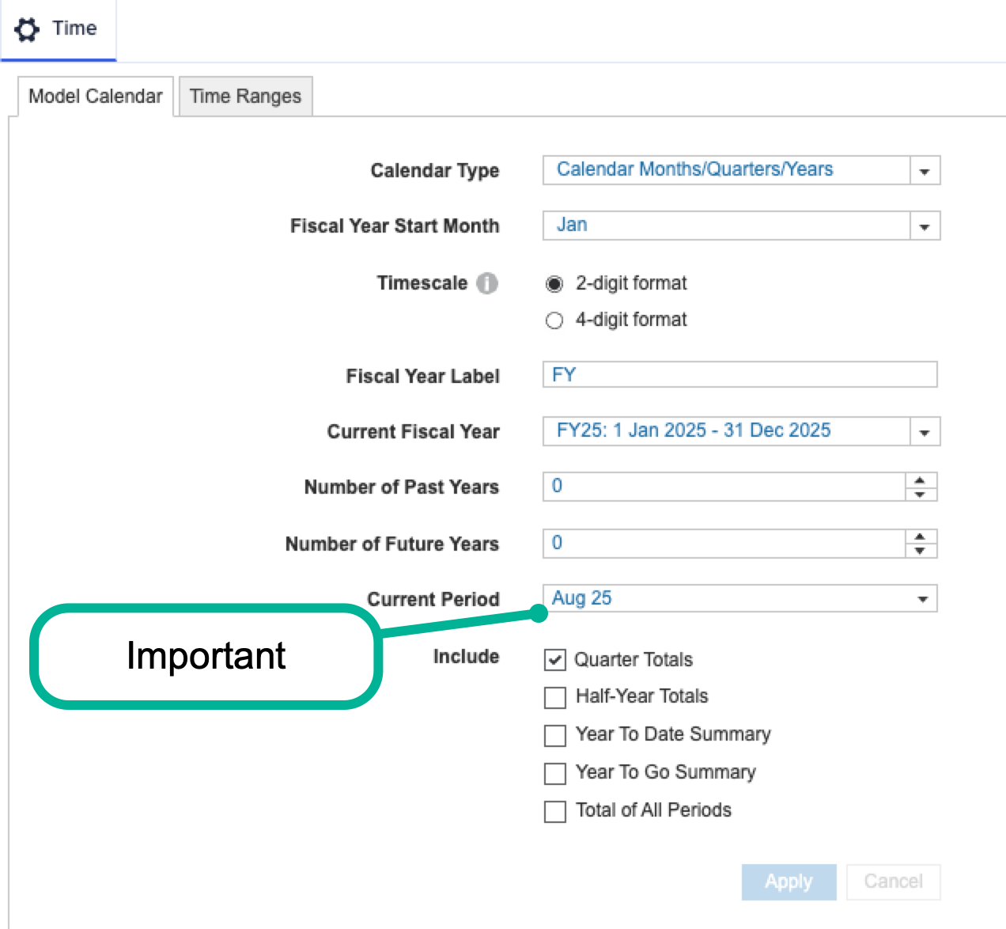
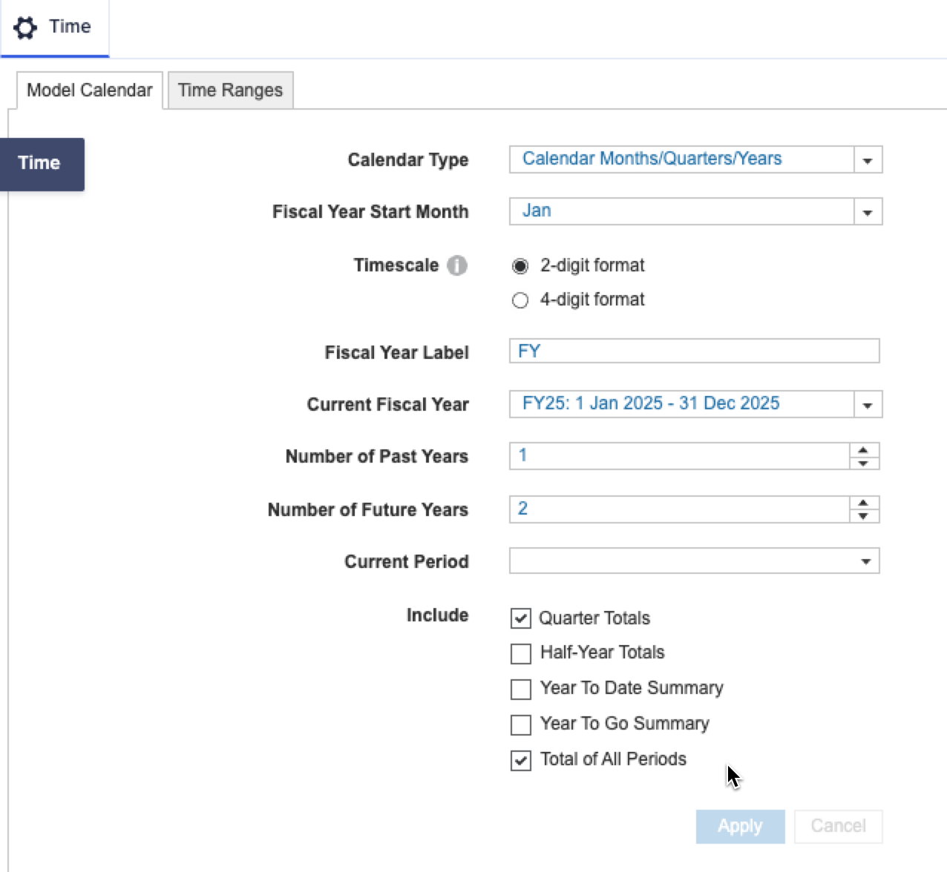
Update time settings & time ranges to match customer needs
Data Hub model
Spoke model
Fiscal Year Start Month – match to customer
Current Fiscal Year – match to customer
Update Current Fiscal Year - match to customer
Update Fiscal Year Start Month - match to customer
Number of Past Years – 1 to 2
Number of Future Years – 1
Select Total of All Periods
Note: Make time changes before the first data load.

Slide 12
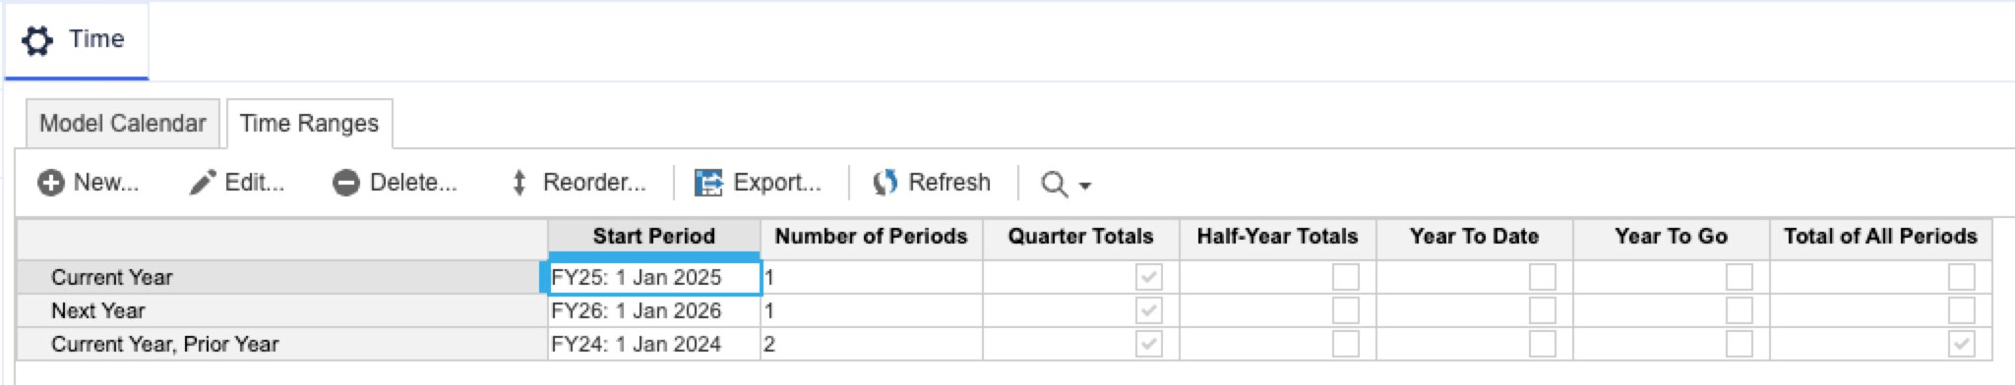
Time ranges - Spoke
Overview:
Time ranges, like model calendars, may need to be updated after generation (SPT-1681).
Action required:
Enter or update time ranges to align with the current appropriate planning periods based on the customer's calendar settings.

Slide 13
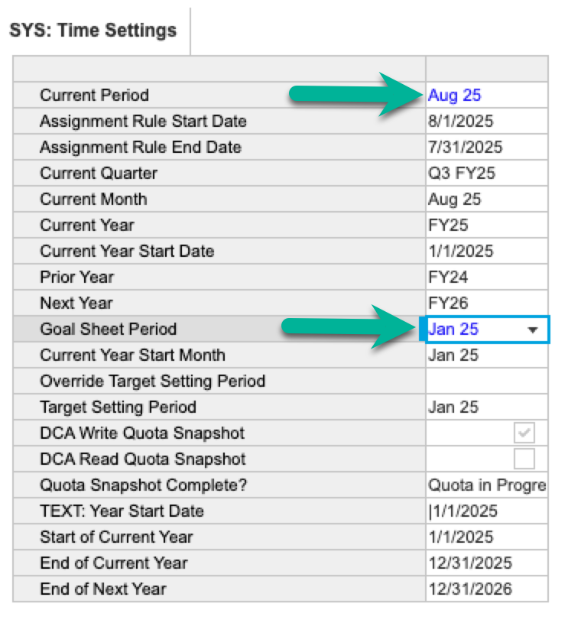
Time settings module - spoke
Overview
Current Period and Goal Sheet Period should be set in the time settings module, or in pages Model Assumptions and Inputs and 10.6 Quota Approval and Export, respectively.

Slide 14
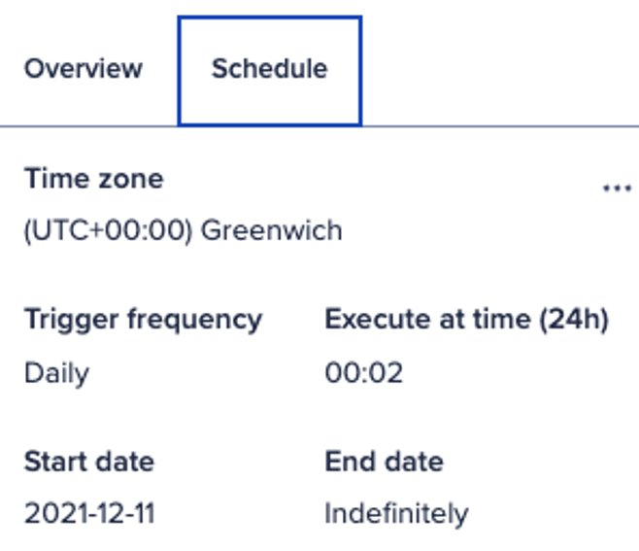
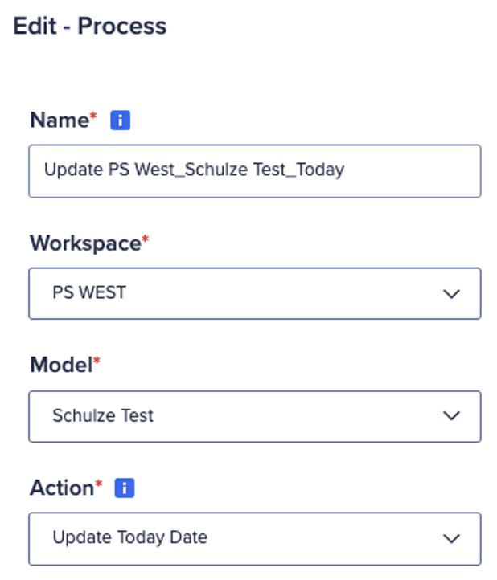
Load ‘Today's Date’ module
Overview
The spoke has a simple way to store today's date: Model Settings > Todays Date.
This is used to keep a record of when items are updated in the model.
An automated daily load should be created to update the date in this module. This can be done with CloudWorks™.
The screenshots show an example
of setup using CloudWorks™:
Process

Slide 15
Post model generation
Saved view & action updates
Section 2

Slide 16
Add notify actions
Helpful Tip
Notify actions will need to be added manually after generating the model (applies to target approvals).
(SPT-270)

Slide 17
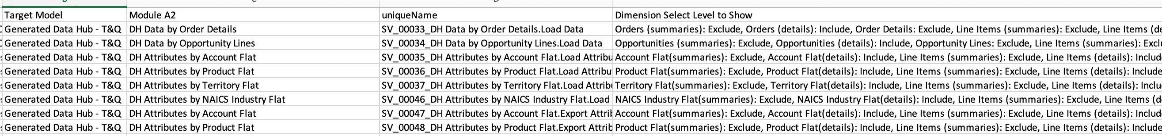
Update saved views
Note: This should be done after loading data to the model so that lists are populated.
Overview
All exports necessary to know how to update saved views are conveniently located in the configurator app page 1.12. Exports for Generated Models.​
Run "Saved Views Select Levels to Show" to see which should be updated to include 'Select Levels to show'. (SPT-287)​
Run the export for saved views for line item selection. Changing line item selection can affect imports because some imports map on column number, so make sure to check any dependent imports, particularly to see that list mapping is still working. (SPT-286)​
Check that column filters in particular are applied correctly to saved views. (SPT-323)

Slide 18
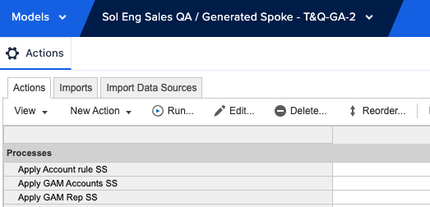
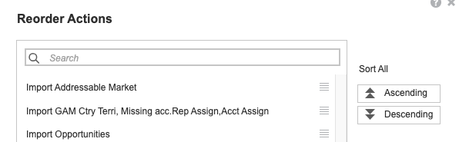
Update actions
Sort:
On the Actions screen, select the reorder button and sort in ascending order. Do this for processes, actions, exports, and other actions

Slide 19
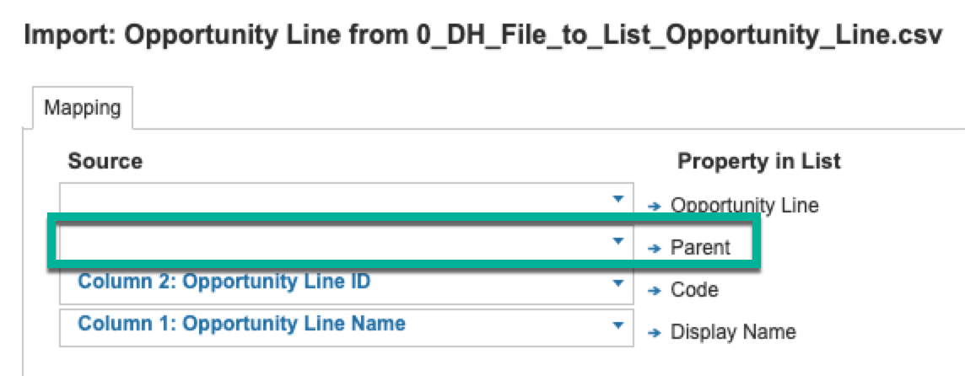
Update actions (cont.)
Column position mapping:
Some imports may be sensitive to column position, for example, if you add a new line item to a saved view, try to add it to the end, so that existing columns do not change position.
A similar situation exists for file imports to the data hub – except that for these imports, it is specifically the list mapping column that must be in column 2 of the source CSV file (may be resolved already).

Slide 20
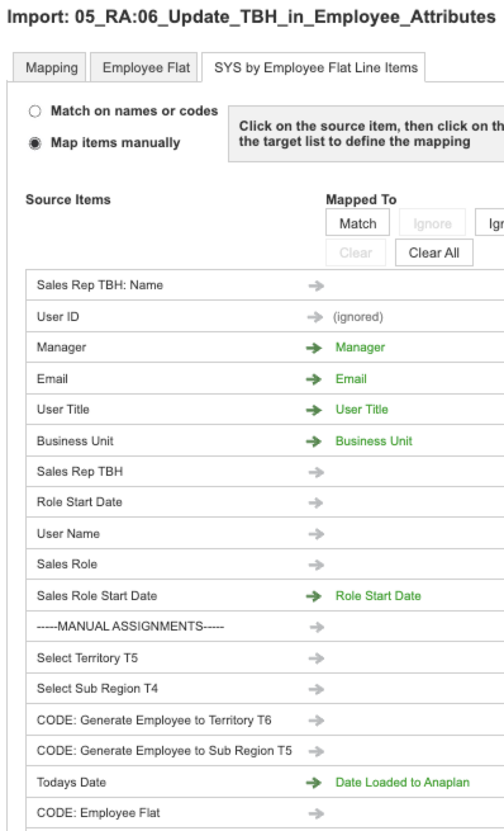
Update Actions (cont.)
On import from saved views to modules, up to 6 manually mapped line items are supported. When the mapping is > 6 items, only the first 6 will be generated.
To know which actions to fix and how to fix them, run export Module Imports Map GT 6 from the generator and use its guidance to update the generated actions.
This export is conveniently located in configurator app page 1.12. Exports for Generated Models.
In the example to the right, you can see that "ignored" does not count as 1 of the 6 mappings.
(Unmapped rows are because saved views are generated without line-item choices, or there were more than 6 mappings.)
(SPT-1052)

Slide 21
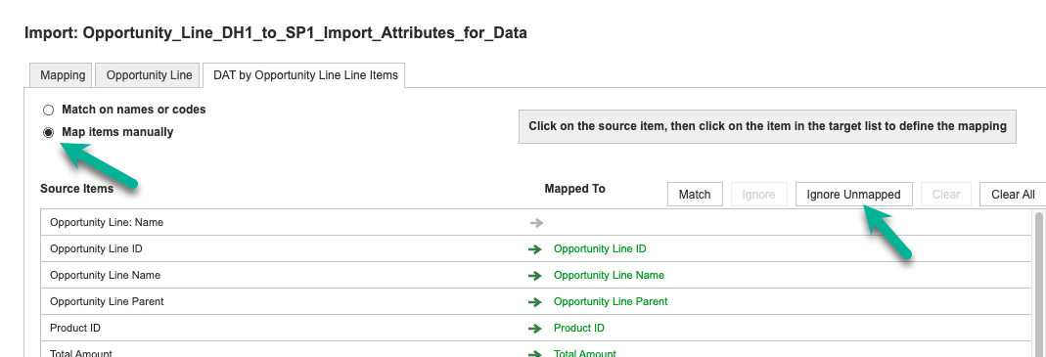
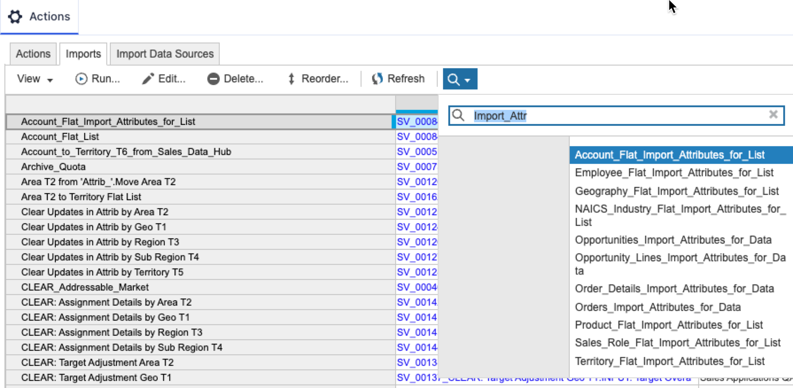
Update Actions (cont.) - Ignore Unmatched on Imports
Ignore unmapped settings:
For spoke imports, you may add "Ignore Unmapped" to the import settings to:
  Reduce noise from warnings
  Decrease execution time
(SPT-51)
Search imports for:
  “import_attr”
  “rule”
(SPT-48)
Note: There may be additional unmapped items present in other imports – please validate that these are intended to be unmapped before ignoring.

Slide 22
Update Actions (cont.) - Target Imports
Orange:
White
(SPT-2710)

Slide 23
Add filters to import saved views
Update filters for saved views:
Add the filters for the following saved views:
Note: Module names may differ in the generated models.
Saved View Name ​ | Filter Name​
Target Imports.Target Import by Territory, Time and other​ | Time Filters and Settings by Quarter.Is Quarter​
Target Imports 2.Target Import by Territory, Time and other​ | Time Filters and Settings by Quarter.Is Quarter​

Slide 24
Create list ordering actions
Overview:
Actions to reorder lists cannot be generated and must be added.
Action required:
The following ordering actions should be created:
Name​ | List​ | In Process​ | Direction​ | Line Item Driver​
Reorder To-Be assignments​ | To-Be Account to Territory​ | N/A​ | ​ | ​
11.3 Reorder Combinations​ | Combinations​ | 6.3 Reorder Rule Combinations​ | Ascending​ | SYS: Combinations.Final Rank​
Sort State list​ | State​ | N/A​ | ​ | ​

Slide 25
Required updates for actions with match on names
Overview
Actions set to match on names may be generated as match manually. This might occur if file headers don’t match the import specification in the data hub.
To fix this:
Update the header to match what is seen on the configurator page 3.05
Reload the data file
Edit the import action

Slide 26
Create mandatory export actions
Overview
The following exports should be created.
Note: Include Row Label Headers of Name and Code for any numbered list
Export Name​ | Reference Saved View​ | Line Item​ | File type​ | Layout​ | Pages​ | Omit Summary Items​ | Empty Rows​ | Include Row Label Headers​
Final Quota Export​ | Quota Export View.Quota by Quota Types​ | ​ | csv​ | Grid​ | Current Page​ | FALSE​ | Omit Empty Rows​ | TRUE; Employee Flat Name and Code, Quota Types Name​
Target Export - Qtr​ | Target Export Template - Qtr.Target Import by Territory, Time and other​ | Imported Target​ | csv​ | Tabular Multiple Column​ | N/A​ | FALSE​ | Include Empty Rows​ | TRUE​
Target Export - Annual​ | Make your own...Filter Not Quarter...choose Imported Target line item only...only bottom levels of hierarchies​ | Imported Target​ | csv​ | Tabular Multiple Column​ | N/A​ | FALSE​ | Include Empty Rows​ | TRUE​
Export Addressable Market Import Template​ | 11_Addressable Market Export Template.CALC: Addressable Mark​ | Addressable Market​ | csv​ | Grid​ | Current Page​ | TRUE​ | Include Empty Rows​ | TRUE; Account Code, Product Name​

Slide 27
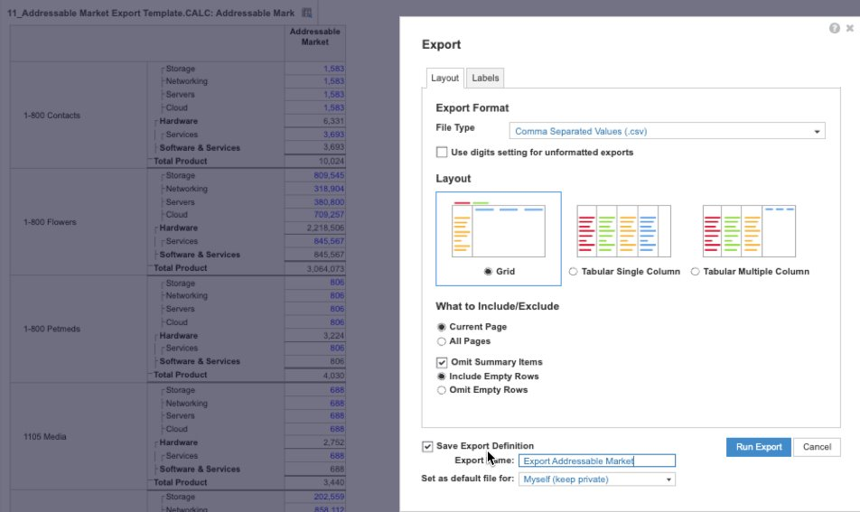
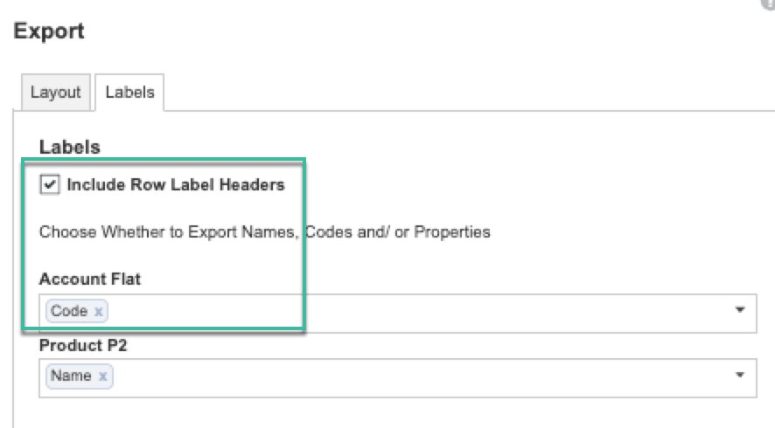
Export definitions – addressable market
Overview
Use the example to help create the export action for the addressable market, which includes a numbered list. This export will be used as a template, so there is an associated import.
Export definition selections: ​
Omit Summary Items​
Include Empty Rows​
Include row header labels​
​
Be sure to show Code, not Name for numbered lists included in the export definition (see previous page)

Slide 28
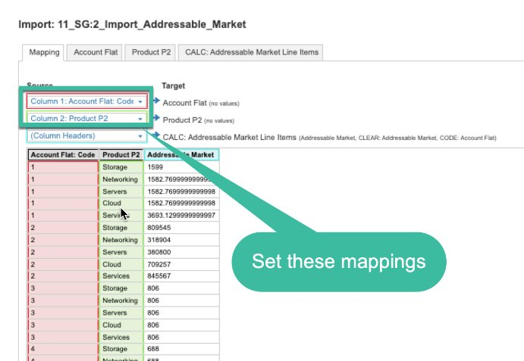
Associated import – addressable market
Overview
After you create the addressable market export you will need to edit the addressable market import to map the appropriate columns.
Action required:
Edit addressable market import 11_SG:2_Import_Addressable_Market
Map the appropriate list to the columns
  Account Flat: Code
  Product P2

Slide 29
Revise process actions to include newly created exports
Overview
After you create the mandatory actions, you will need to add them to the appropriate process actions.
Action required:
Edit and add the appropriate export actions to the list processes
Process​ | Model​
3.1 Export Quarterly Targets​ | Generated Spoke - T&Q​
3.2 Export Yearly Targets​ | Generated Spoke - T&Q​
3.3 Export Addressable Market​ | Generated Spoke - T&Q​

Slide 30
Check Territory hierarchy move or delete processes
Overview
Territory move or delete processes may be missing some actions (SPT-1867), or have repeating actions (SPT-2534).
Action required:
Review the actions in the territory move or delete processes.

Slide 31
Post model generation
Lists & data updates
Section 3

Slide 32
Required list updates
Overview:
Several lists require manual updates after generation
Action to take:
Planning Measure (both data hub and spoke model)​
  Edit Planning Measure list in data hub and spoke to have codes matching your data source file.​
  Edit Planning Measure list to NOT have a top member.​
Ramp Periods (spoke model only)
  Update the sort order of the ramp periods (if necessary)
For any attributes set as "Enable for Validation" but not "Enable for Auto Create" in configurator page "1.01 Data Hub Setup", you will want to manually add items to that list in data hub. You can do so from the model builder UX, or in a user UX page that uses an add form. Example from template: Account Type.

Slide 33
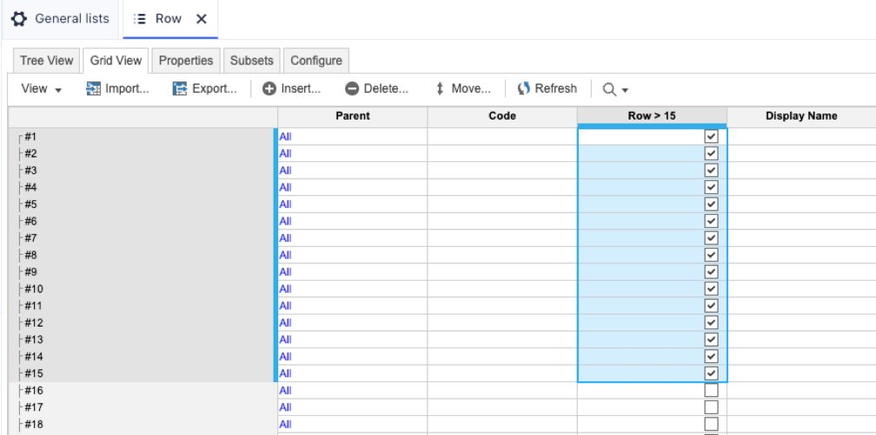
Required list member additions
Overview:
Several lists require manual additions to list members after generation
Action to take:
Quota Types (spoke model only)​
  Add more quota types, if necessary, in your development model and ALM to the production model.
​Row List (spoke only)
  Add list members in the model builder ux so there are 1,000 total list members
  Ensure that numbers 1 – 15 are included in the ROW > 15 Subset

Slide 34
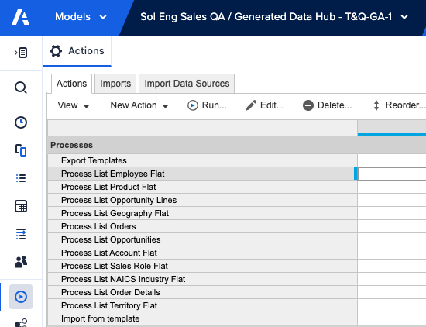
Initial model loads & setup
Gather data files
  List data for territory, account, product, employees
  Include transactional data for sales and opportunities
Method 1 for loading data:
  Publish each data hub process "<list>_from_Files" to a classic dashboard; this way you can test each set of imports independently. Make sure you have them in logical order.
Method 2 for loading data:
  Publish process "import from template" in data hub to a classic dashboard (* new customers do not have classic dashboards enabled)
  Either method:
  Run the data hub imports and validate saved views in the data by/attribute by modules
  Load data to spoke T&Q model with process Load_All_Lists_and_Data_from_HUB

Slide 35
More data setup
Category 13. Model Setup and Assumptions.
The values entered will vary from customer to customer. All inputs in dashboards should be filled in:
  Map Setup – used to visualize countries and states based on territory association
  Model Assumptions and Inputs – used for setting up current period, quota method, sales roles, ramp profiles, quotas, approvals, etc.
  Seasonality Assumptions – used to allocate data from quarters to month
Category 13.Role-based Quota Setup.
  Role-based quota – If using, control it from here.
Category 02. Historical Sales and Account Value.
To ensure potential spend is calculated, you will need to take the following actions:
  Page 2.3 Set and Score Potential Account Value & Override Segment. Update the default assumptions in the Additional Insights panel
  Page 2.2 Import Addressable Market. Load addressable market data
.

Slide 36
Post model generation
Module & line item updates
Section 4

Slide 37
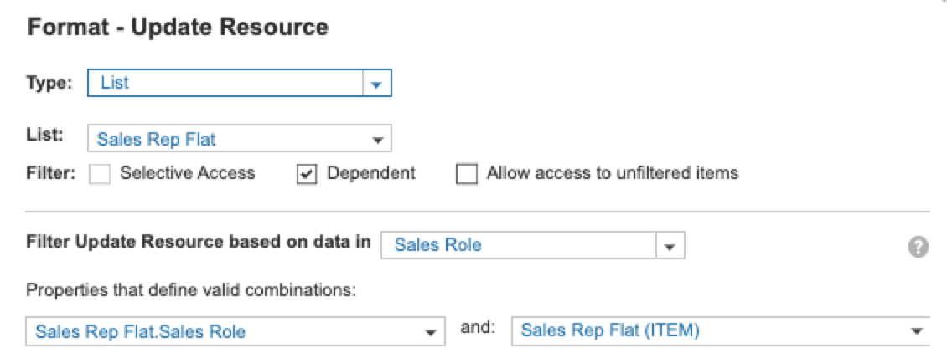
Line items with dependent dropdowns
Module.Line Item Name | Dependent Dropdown
Resource Assignment by Area T2, Sales Role Flat, Month.Update Resource | Based on data in Sales Role
CALC: Resource Assignment by Geo T1.Update Resource | Based on data in Sales Role
CALC: Resource Assignment by Area T2.Update Resource | Based on data in Sales Role
CALC: Resource Assignment by Region T3.Update Resource | Based on data in Sales Role
INPUT: Rule Table Entry.Ship to State – Province | Based on data in country (or whichever list is used as parent) = ACCEPT DEFAULT
INPUT: Rule Table Entry.Ship to City | Based on data in state (or whichever list is used as parent) = ACCEPT DEFAULT
Example:
Overview:
Several line items require dependent dropdowns to be added.
Action Required:
Update the line items identified in the table to use dependent dropdowns.
(SPT-506)

Slide 38
Post model generation
App pages updates
Section 5

Slide 39
Check number and line item formats
Helpful Tip
Update line item formats and styles to match template app.

Slide 40
Check context selectors
Helpful Tip
Compare page context selectors to the template app and adjust accordingly (hide, filter, select)
(SPT-293, SPT-452)

Slide 41
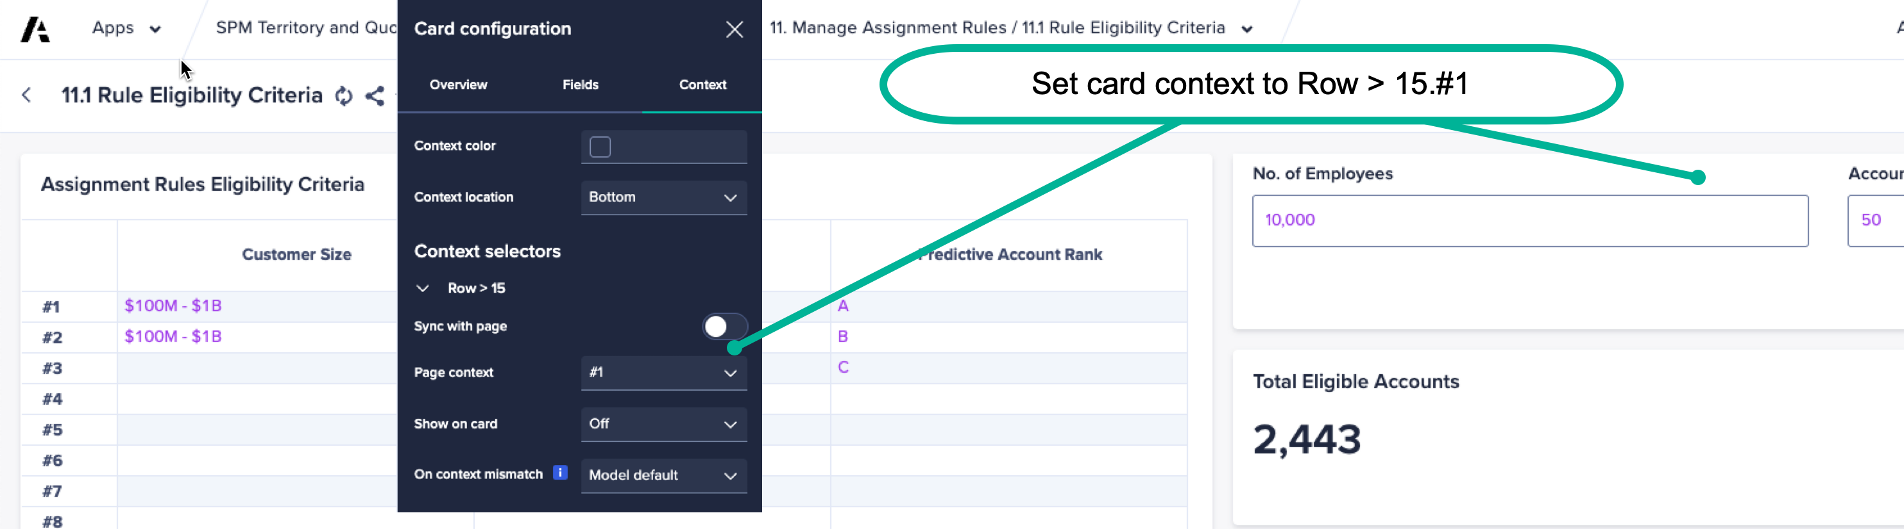
Context selectors
Example
(SPT-293, SPT-452)

Slide 42
Check dynamic text card
Helpful Tip
Ensure that the dynamic text in text cards is tied to the dimension that the dynamic text suggests.​

Slide 43
Update page objects driven from list subsets
Helpful Tip
Check and update any page objects that use list subsets to ensure the list subset is applied.

Slide 44
Update map data sources
Helpful Tip
For any page that includes maps, update the data source (modules, line-items, etc) using the template application as the example. The metrics displayed for all map layers may need to be adjusted as well.
(SPT-1113)​

Slide 45
Grid updates
UX grids set to synchronize scrolling are not always generating that way.
  See for example page “Model Assumptions and Inputs”, grids “Setup Quota Type” and “Product Selection”.
  Synchronized grids should be expected where 2 grids are side by side with the same list on rows. (SPT-294)
Grids that in the template have a hierarchy filter turned on will generate without it.
  Example, page 9.3 Named Account Quota, grid "Quota by Named Account Child". (SPT-562)
UX grids whose page context selectors are choosing line items with Show/Hide: you will need to select the line items manually and save the page.
  Example: page 10.6. (SPT-741)
On Top-Down HC Target Setting pages, for all line items named "NTE +/- HC Target" on grids,
  Hide lowest level of role grade and/or job family on columns to match template app
Customized grid header sizes are ignored.
  You will need to set them manually. (SPT-1150).
  Make sure no/very little side scrolling on grids,
  Change column height to 2 instead of 3 where you appropriate.

Slide 46
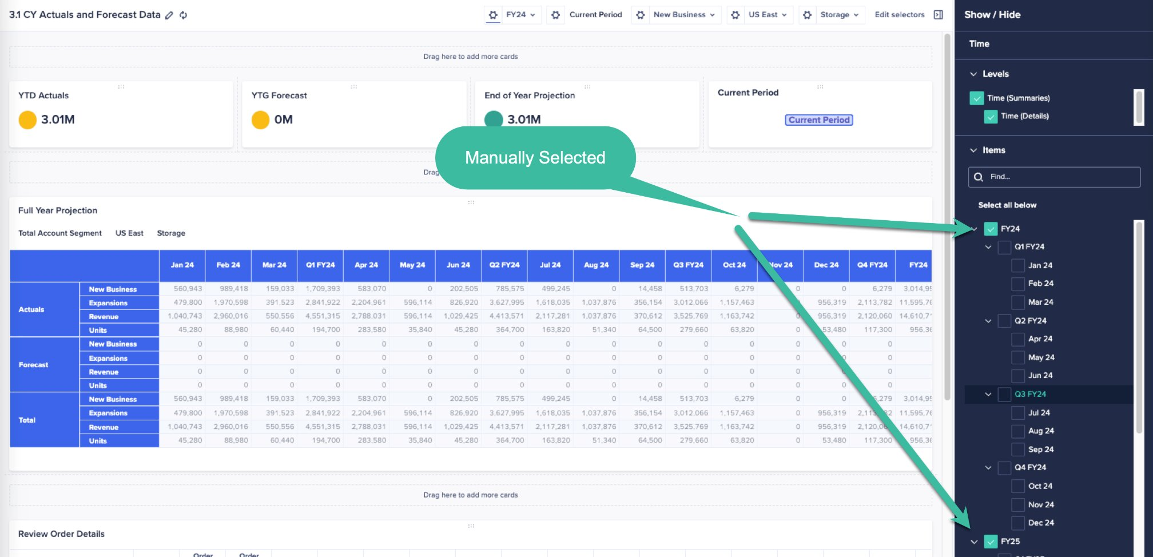
KPI time selections updates
On page 3.1 Review page context manual selection by comparing to the template, update the page context dropdown manual selections and filters

Slide 47
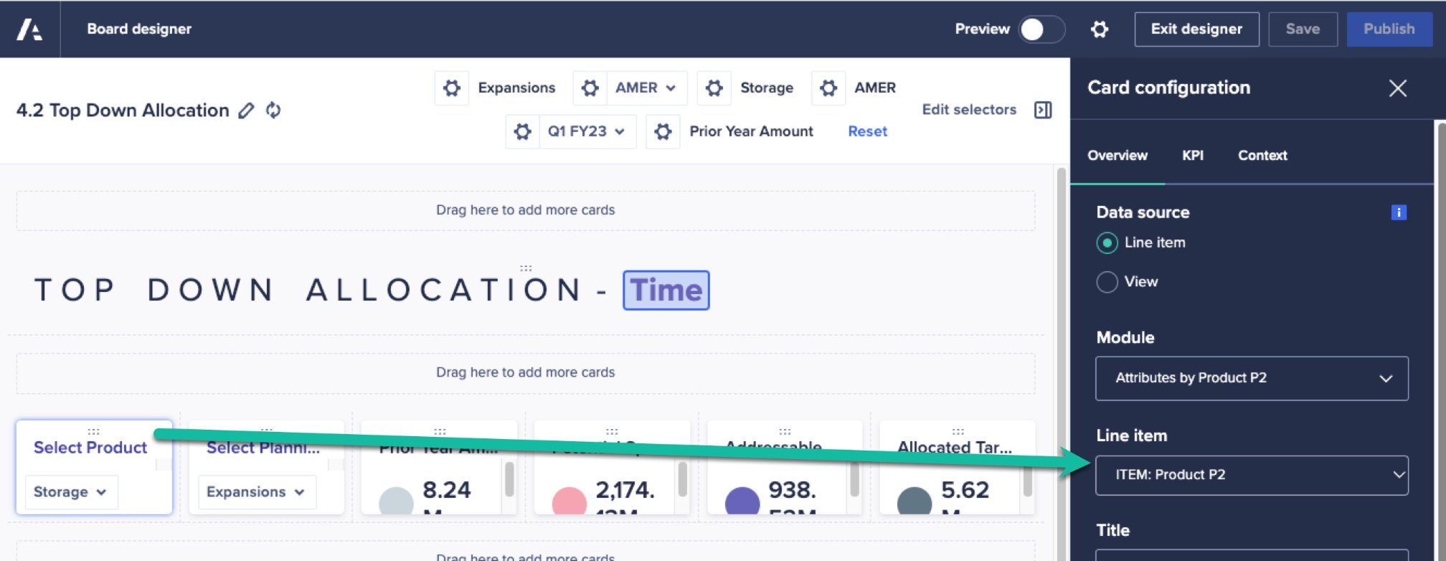
KPI for list selection
When a template page uses a KPI card for list selection on a grid, the line item used may need to be manually updated to match the customer's specifications. (SPT-667)

Slide 48
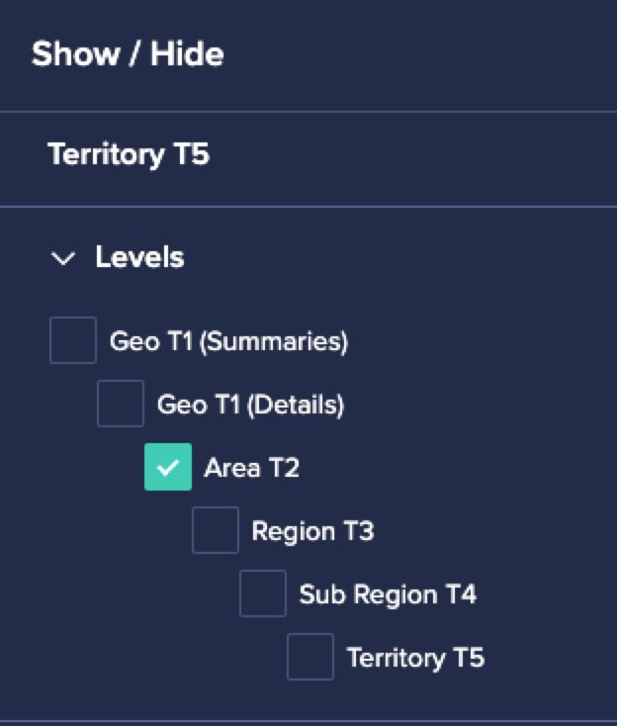
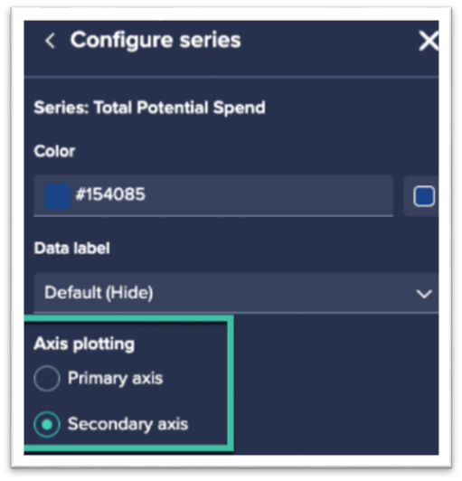
Graph selection updates
Page 4.3 Example
Graph level selection
  Review all pages that include graphs to be sure the graph level selection on hierarchies is correct.
  Example: page 4.3 Geo Goal Overallocation
  (SPT-382, SPT-621)​
Graph secondary axis
  Review all pages that include graphs to ensure all secondary axis selections are correct (compare to the template application as needed).
  Example: page 7.2 Manage Territory Account Assignments
  (SPT-512)
Combination charts
  Check all combination charts against to the template application to ensure the appropriate selections and settings.
Page 7.2 Example

Slide 49
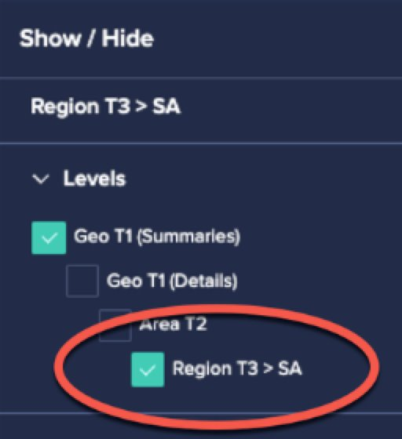
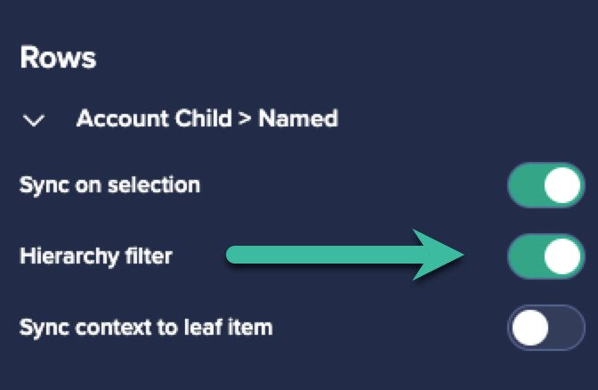
Subset selections – page updates
Page 8.3 Example
Grid level selection on subsets
  Grids using level selections on a subset will need to be adjusted.
  Example: page 8.3 on grid “Finance Targets”
    Change grid level selection for the subset Region T3 > SA
  (SPT544)
Grid hierarchy filter on subset
  Update grids that use hierarchy filters on subsets; these pages will generate without these included.
  Example: page 9.3 Named Account Quota
  (SPT-562)
Page 9.3 Example
Grid pivot for line items subsets
  Grids using line item subsets may need to be repivoted (compare to the template application as needed)
  Example: page 3.5, grids "Override Default Allocation Method by Area" and "Override Default Allocation Method by Territory".
  (SPT-457)​

Slide 50
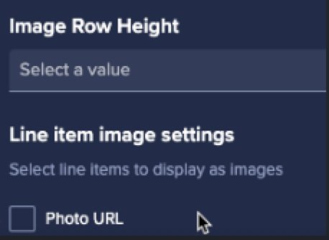
Additional page updates
Form Driver Line Items
  Adjust add form/action’s line item driver. Compare to the template application.
  Page 7.5 Manage Account Hierarchy
  (SPT-370)
Page 6.1 Example
Photo URL
  If you are using employee photos the Photo “Photo URL” checkbox will need to be selected.
  Page: 6.1 Resource Roster and Manage TBH
    Grid: Resource Roster
  (SPT-328)
Line Items Referenced
  There are some rare cases where a selected line item may be set to "TEMP". This happens if
    Your customer doesn't have an appropriate line item corresponding to the template line item
    There was an issue with applying adaptive mapping in the configurator (SPT-2109)

Slide 51
Post model generation
Security updates
Section 6

Slide 52
Updates to user roles & security
User roles and security should be added and configured based on each customer's unique requirements. The application does not come with user roles or security by default.
Example Roles to add to Model:
Sales Operations
Sales VP / Area VP / Regional VP
Sales Manager
Revenue Leader
Selective Access:
Territory Hierarchy (apply selective access to the appropriate hierarchy level)
Page Level Access:
Assign access to the relevant roles

